Slide 1
CS 2009 Design and Analysis of Algorithms
Waheed Ahmed
Email : waheedahmed@nu.edu.pk

Slide 2
Lecture 2: Growth of Functions Thomas H. Coreman (CLRS), Chapter 3.

Slide 3
Complexity analysis- One Loop
Problem: Does array A contain the integer t? Given A (array of
length n) and t (an integer). \\\\
for (i = 0; i<n ; i++):
if A[i] == t:
return true
return false
Question: What is the running time?

Slide 4
Complexity analysis- One Loop
The running time is:
1 assignment (i = 0)
n+1 comparisons (i < n)
n increments (i++)
n array offset calculations (a[i])
n comparisons (a[i] == K)
a + b(n + 1) + cn + dn + en, where a, b, c, d, and e are constants depend upon machine
Easier just to say O(n) (constant-time) operations

Slide 5
Complexity analysis- One Loop
Problem: Does array A contain the integer t in first 5 elements? Given A (array of length n) and t (an integer). \\\\
for (i = 0; i<5 ; i++):
if A[i] == t:
return true
return false
Question: What is the running time? O (k) where k = 5

Slide 6
Complexity analysis- Two Loops
Problem: Given A;B (arrays of length n) and t (an integer). [Does A or B
contain t?] \\\\
for (i = 0; i<n ; i++):
if A[i] == t:
return true
for (i = 0; i<n ; i++):
if B[i] == t:
return true
return false
Question: What is the running time?
Question: What is the running time? O(n)

Slide 7
Complexity analysis- two Nested Loops
Problem: Do arrays A;B have a number in common? Given arrays
A; B of length n \\\\
for (int i = 0; i < n; i++){
for (int j = 0; j < n; j++){
if (A[i] == B[j]):
return true
}
}
return false
Question: What is the running time? O(n²)

Slide 8
MULTIPLICATION PROBLEM
4456
x 1123
13368
89120
445600
4456000
5004088

Slide 9
MULTIPLICATION PROBLEM
4456
x 1123
13368
89120
445600
4456000
5004088
Algorithm description (informal*): compute partial products (using multiplication & “carries” for digit overflows), and add all (properly shifted) partial products together

Slide 10
MULTIPLICATION PROBLEM
n digits
12345678998765432101
x 98765432112345678901
How efficient is this algorithm?
(How many single-digit operations are required?)
Notes:
How efficient is this algorithm? How many single-digit operations are required? First we will multiply 3 with n digits

Slide 11
MULTIPLICATION PROBLEM
n digits
12345678998765432101
x 98765432112345678901
n partial products: ~2n² ops (at most n multiplications & n additions per partial product)
adding n partial products: ~2n² ops (a bunch of additions & “carries”)
How efficient is this algorithm?
(How many single-digit operations are required?)
~ 4n² operations in the worst case

Slide 12
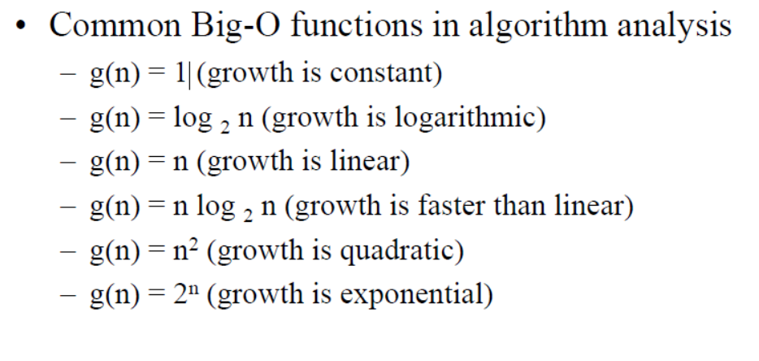
Growth of Function
Growth functions are used to estimate the number of steps an algorithm uses as its input grows.

Slide 13
Growth of Function
n | log2n | n log2n | n² | 2^{n}
1 | 0 | 0 | 1 | 2
2 | 1 | 2 | 4 | 4
4 | 2 | 8 | 16 | 16
8 | 3 | 24 | 64 | 256
16 | 4 | 64 | 256 | 65536
32 | 5 | 160 | 1024 | 4294967296
64 | 6 | 384 | 4096 | 1.84467E+19

Slide 14
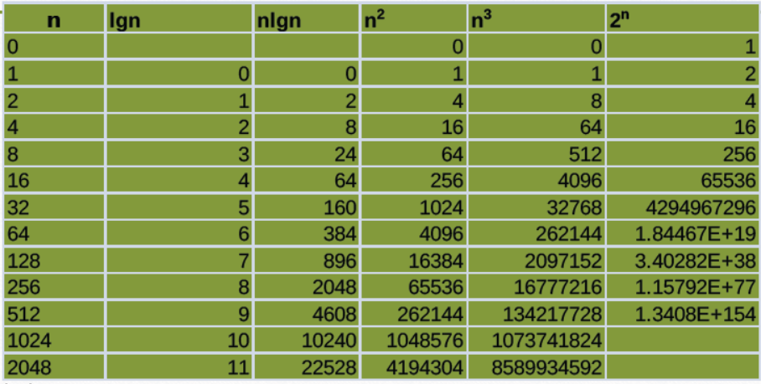
Growth of Function

Slide 15
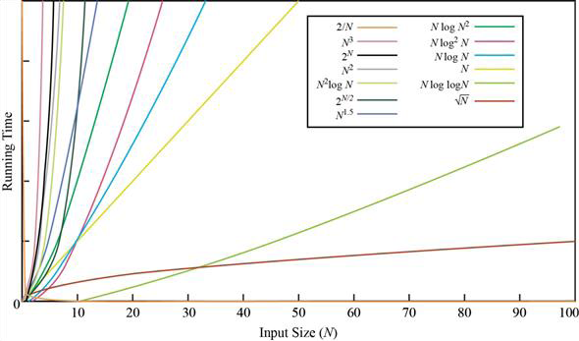
Growth of Function

Slide 16
Growth of Function

Slide 17
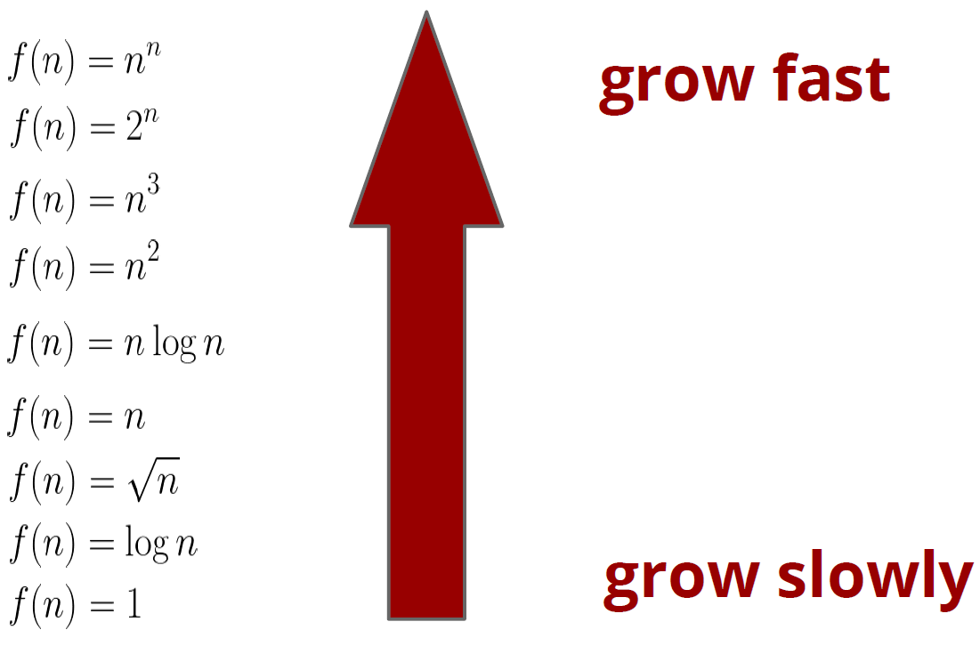
Growth Rate Ranking of Function?

Slide 18
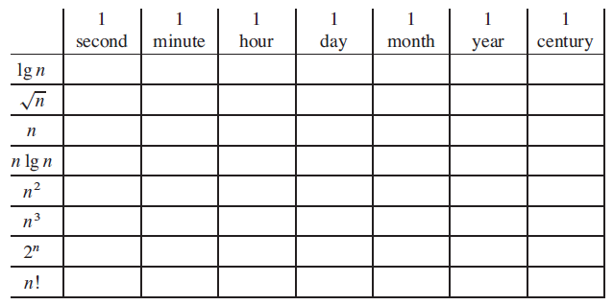
Growth Rate Ranking of Function?
Comparison of running times
For each function f (n) and time t in the following table, determine the largest size n of a problem that can be solved in time t, assuming that the algorithm to solve the problem takes f(n) microseconds. (10⁶)

Slide 19
Efficiency of Algorithm
INTRODUCING...
ASYMPTOTIC ANALYSIS

Slide 20
Efficiency of Algorithm
INTRODUCING...
ASYMPTOTIC ANALYSIS
Some guiding principles:
we care about how the running time/number of operations scales with the size of the input (i.e. the runtime’s rate of growth),
Not concerned with small values of n, Concerned with VERY LARGE values of n.
Asymptotic –refers to study of function f as n approaches infinity

Slide 21
ASYMPTOTIC ANALYSIS (High Level Idea)
We’ll express the asymptotic runtime of an algorithm using
BIG-O NOTATION
We would say Multiplication “runs in time O(n²)”
Informally, this means that the runtime “scales like” n²

Slide 22
ASYMPTOTIC ANALYSIS (High Level Idea)
We’ll express the asymptotic runtime of an algorithm using
BIG-O NOTATION
We would say Multiplication “runs in time O(n²)”
Informally, this means that the runtime “scales like” n²
THE POINT OF ASYMPTOTIC NOTATION
suppress constant factors and lower-order terms
too system dependent
irrelevant for large inputs

Slide 23
ASYMPTOTIC ANALYSIS (High Level Idea)
BIG-O NOTATION
THE POINT OF ASYMPTOTIC NOTATION
suppress constant factors and lower-order terms
too system dependent
irrelevant for large inputs
Example f(n) = 2n² + 4n + 1
f(n) = n² is the dominant term and the term 4n + 1 becomes insignificant as n grows larger.

Slide 24
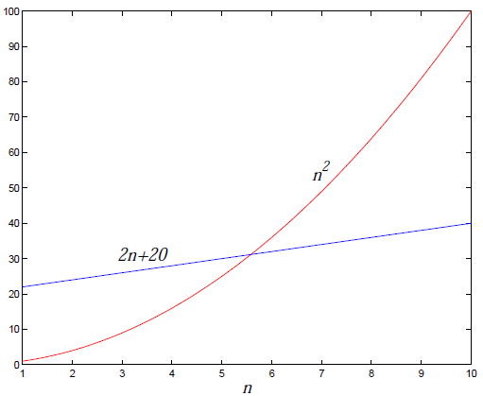
ASYMPTOTIC ANALYSIS (High Level Idea)
THE POINT OF ASYMPTOTIC NOTATION
suppress constant factors and lower-order terms
too system dependent
irrelevant for large inputs
f₁ (n) = n²
f₂ (n) = 2n + 20
Which is better?
Notes:
which values of n f₁ (n) is better than f2(n) and

Slide 25
ASYMPTOTIC ANALYSIS (High Level Idea)
THE POINT OF ASYMPTOTIC NOTATION
suppress constant factors and lower-order terms
too system dependent
irrelevant for large inputs
2500
when n is small...
2000
0.1n^{1.6} + 300
1500
Runtime (ms)
1000
0.008n²
500
0
0
100
200
300
400
500
600
n (input size)

Slide 26
ASYMPTOTIC ANALYSIS (High Level Idea)
THE POINT OF ASYMPTOTIC NOTATION
suppress constant factors and lower-order terms
too system dependent
irrelevant for large inputs
2500
when n is small...
50000
2000
40000
0.1n^{1.6} + 300
1500
30000
Runtime (ms)
Runtime (ms)
1000
0.008n²
20000
500
10000
when n gets bigger!
0
0
0
100
200
300
400
500
600
0
1000
2000
3000
4000
5000
6000
n (input size)
n (input size)
Notes:
First graph is for input size in 100

Slide 27
ASYMPTOTIC ANALYSIS (High Level Idea)
THE POINT OF ASYMPTOTIC NOTATION
suppress constant factors and lower-order terms
too system dependent
irrelevant for large inputs
2500
when n is small...
O(n^{1.6})
50000
2000
40000
0.1n^{1.6} + 300
1500
30000
Runtime (ms)
Runtime (ms)
1000
0.008n²
20000
500
10000
when n gets bigger!
O(n²)
0
0
0
100
200
300
400
500
600
0
1000
2000
3000
4000
5000
n (input size)
n (input size)

Slide 28
ASYMPTOTIC ANALYSIS (High Level Idea)
To compare algorithm runtimes in this class, we compare their Big-O runtimes
Ex: a runtime of O(n²) is considered “better” than a runtime of O(n³)
Ex: a runtime of O(n^{1.6}) is considered “better” than a runtime of O(n²)
Ex: a runtime of O(1/n) is considered “better” than O(1) ?

Slide 29
RUNTIME ANALYSIS
There are a few different ways to analyze the runtime of an algorithm:
Worst-case analysis:
What is the runtime of the algorithm on the worst possible input?
Best-case analysis:
What is the runtime of the algorithm on the best possible input?
Average-case analysis:
What is the runtime of the algorithm on the average input?

Slide 30
RUNTIME ANALYSIS
There are a few different ways to analyze the runtime of an algorithm:
We’ll mainly focus on worst case analysis since it tells us how fast the algorithm is on any kind of input
Worst-case analysis:
What is the runtime of the algorithm on the worst possible input?
Best-case analysis:
What is the runtime of the algorithm on the best possible input?
Average-case analysis:
What is the runtime of the algorithm on the average input?

Slide 31
BIG-O NOTATION
Let f(n) & g(n) be functions defined on the positive integers. (In this class, we’ll typically write T(n) to denote the worst case runtime of an algorithm)
What do we mean when we say “f(n) is O(g(n))”?
Mathematical Definition
Pictorial
Definition

Slide 32
BIG-O NOTATION
Let f(n) & g(n) be functions defined on the positive integers. (In this class, we’ll typically write Tfn) to denote the worst case runtime of an algorithm)
What do we mean when we say “f(n) is O(g(n))”?
In Math
f(n) = O(g(n)) (which means that “f grows no faster than g”) if and only if there exists positive constants c and n₀ such that for all n ≥ n₀
f(n) ≤ c · g(n)
Pictorial
Definition

Slide 33
BIG-O NOTATION
Let f(n) & g(n) be functions defined on the positive integers.
What do we mean when we say “f(n) is O(g(n))”?
In Math
f(n) = O(g(n)) (which means that “f grows no faster than g”) if and only if there exists positive constants c and n₀ such that for all n ≥ n₀
f(n) ≤ c · g(n)
In Pictures
n₀
c·g(n)
f(n)
Runtime (ms)
g(n)
n (input size)

Slide 34
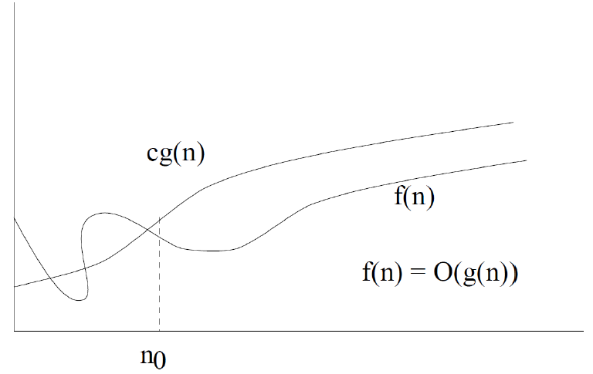
BIG-O NOTATION
Let f(n) & g(n) be functions defined on the positive integers.
What do we mean when we say “f(n) is O(g(n))”?
In Math
f(n) = O(g(n)) (which means that “f grows no faster than g”) if and only if there exists positive constants c and n₀ such that for all n ≥ n₀
f(n) ≤ c · g(n)
In Pictures

